Slide 1
REVOCABLE BIOMETRIC SYSTEM BASED ON LOG GABOR FEATURES AND HOG FEATURES
- A COMPARATIVE STUDY
-Arpita Nema(202116004)
-Ambuj Mishra(202116003)

Slide 2
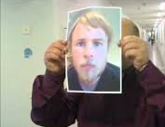
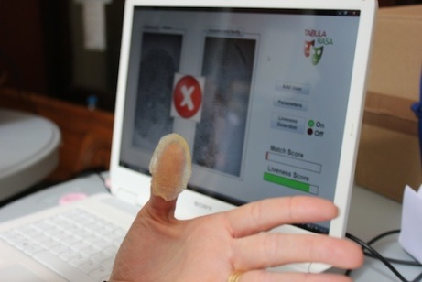
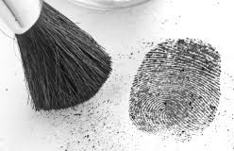
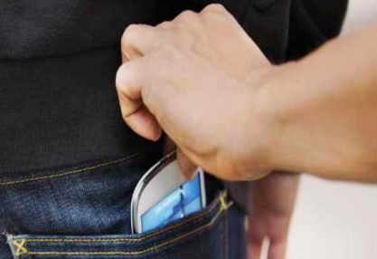
Biometrics - A Double Edged Sword
Biometrics - the most advanced security solutions in the market.
Biometrics offers greater security and convenience than traditional methods of personal recognition.
Biometrics for security and security for biometrics
Risks - Leaking a Biometric is a Disaster
Password leaked? Fine, you can easily replace with a new one.
Fingerprint leaked? Leaked for the rest of your life.
Lack of general solutions leaves this as a challenging issue.

Slide 3
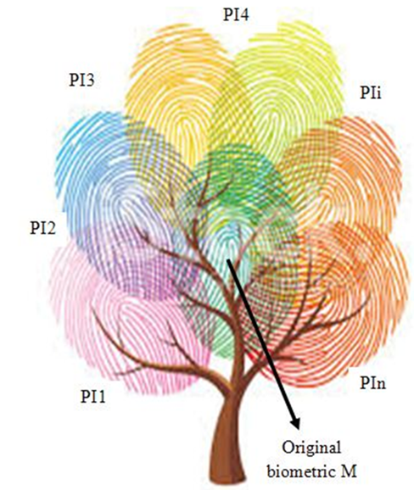
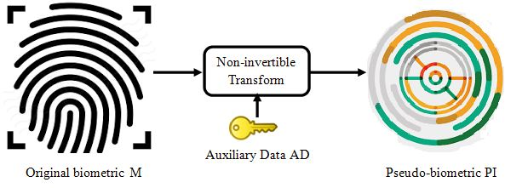
Cancelable Biometrics
Regenerate biometrics like passwords.
Use ‘pseudo-identity’ PI instead of original biometric for storing, matching and other authentication tasks.
Assign a token to every enrollee which generates/lead to generate this user-specific secret information.
In case of a compromise only pseudo-identity PI is lost,
which cannot be inverted to learn original biometric.

Slide 4
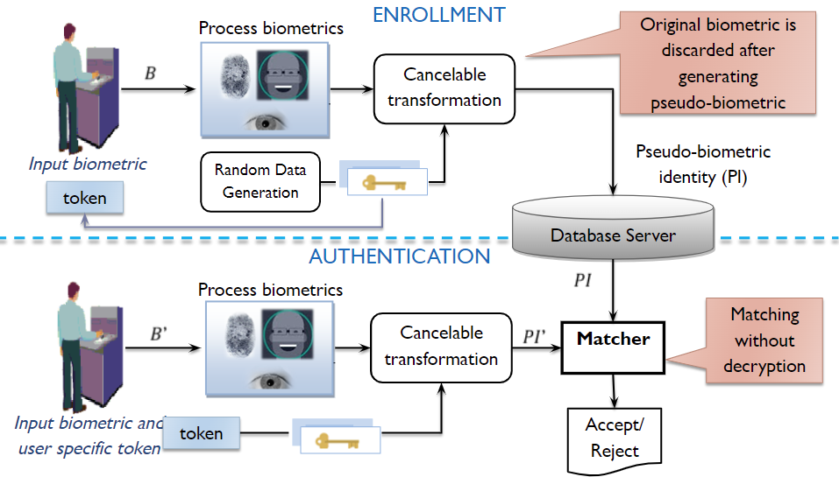
Basic Cancelable Authentication System

Slide 5
Approach-1
Log-Gabor and XOR based Revocable Biometric System

Slide 6
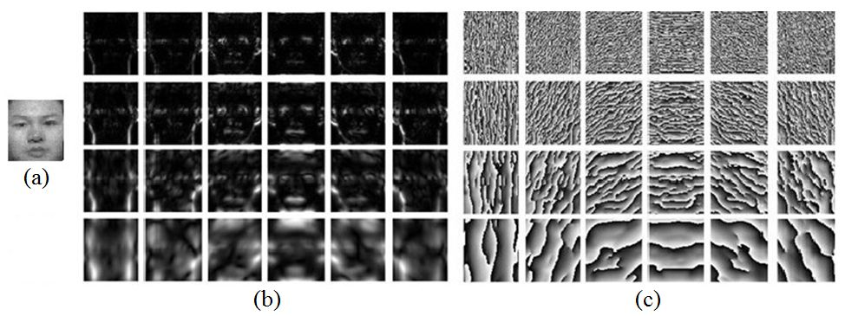
Log-Gabor Filters
Input image Feature extraction Feature transformation.
Feature extraction
Log-Gabor filters at multiple scales (4) and orientations(6).
Significant increase in dimensionality of feature (24 times).
Fig.- Sample images for log-Gabor filtering (a) Original image, (b)-(c) Log-Gabor magnitude and phase patterns at n=4 scales and m=6 orientations.

Slide 7
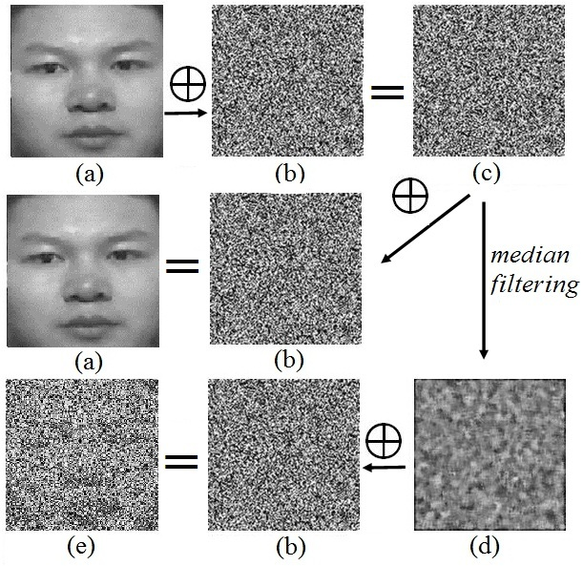
Non-invertibility using Median Filtering
Fig.- (1st row) : Face Image in (a) is XORed with random grid RG in (b) and results is (c);
(2nd row) : Output in (c) when XORed with RG in (b), recovers the original image (a);
(3rd row) : Median filtered output in (d) when XORed with RG (b) recovers lossy image (e).

Slide 8
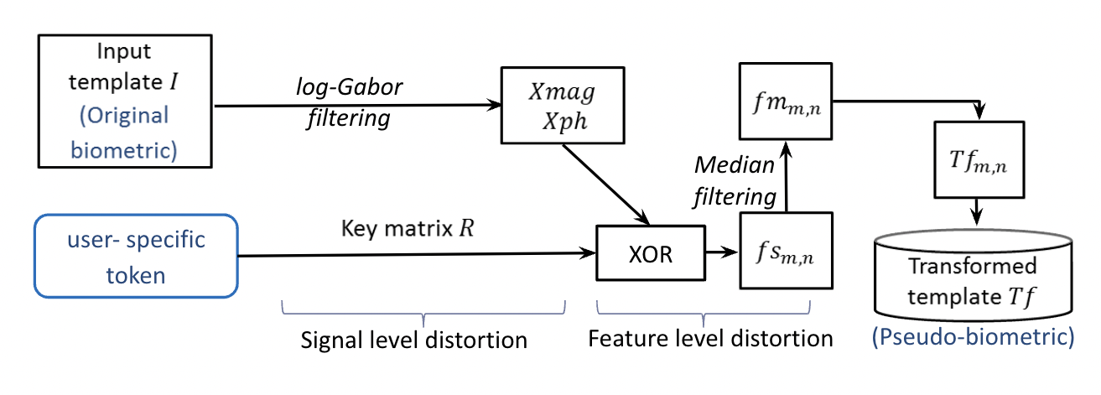
Proposed Approach
Dimensionality reduction is performed using Kernel discriminant analysis(KDA). Further, matching was done using cosine similarity.

Slide 9
Observations
XOR based salting with median filtering fulfills the required criteria.
No contribution of the transformation approach towards dimensionality reduction.
Need to develop a transformation approach that reduces the dimensionality while simultaneously fulfilling the cancelability requirements.

Slide 10
Approach-2
HOG Features and Random Distance based Revocable Biometric System

Slide 11
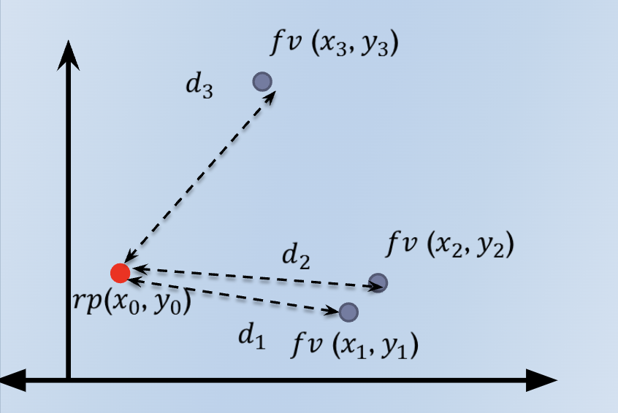
Proposed Concept
Let the feature vector f_{v} be represented as a point (x_{i}, y_{i}) in a Cartesian coordinate system. Then, instead of using original feature f_{v}, its distance from some random point (x₀, y₀) can be used for matching purposes.

Slide 12
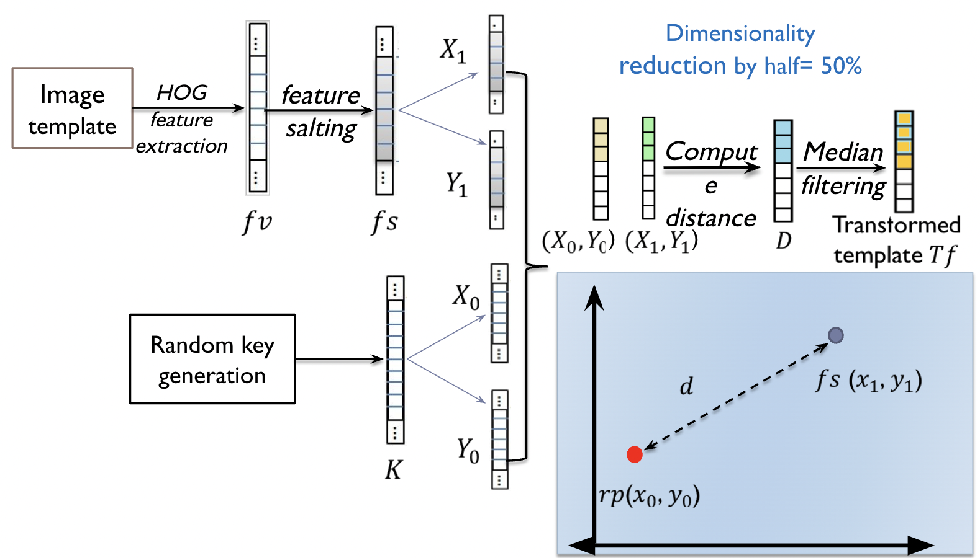
Proposed Approach

Slide 13
Implementation and Results
We did a 10-fold stratified cross-validation of the whole data to get the generalized results and evaluate the performance of the revocable biometric system on the ORL face database.

Slide 14
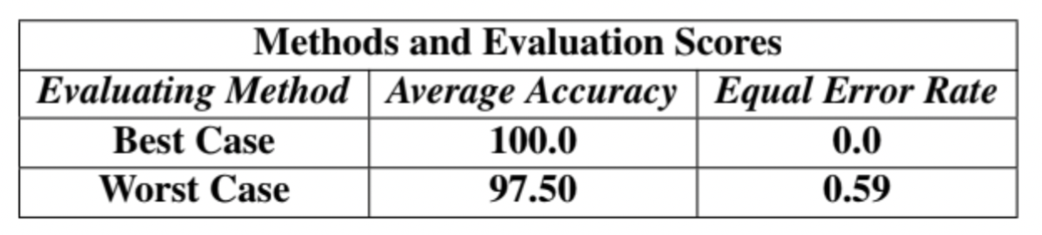
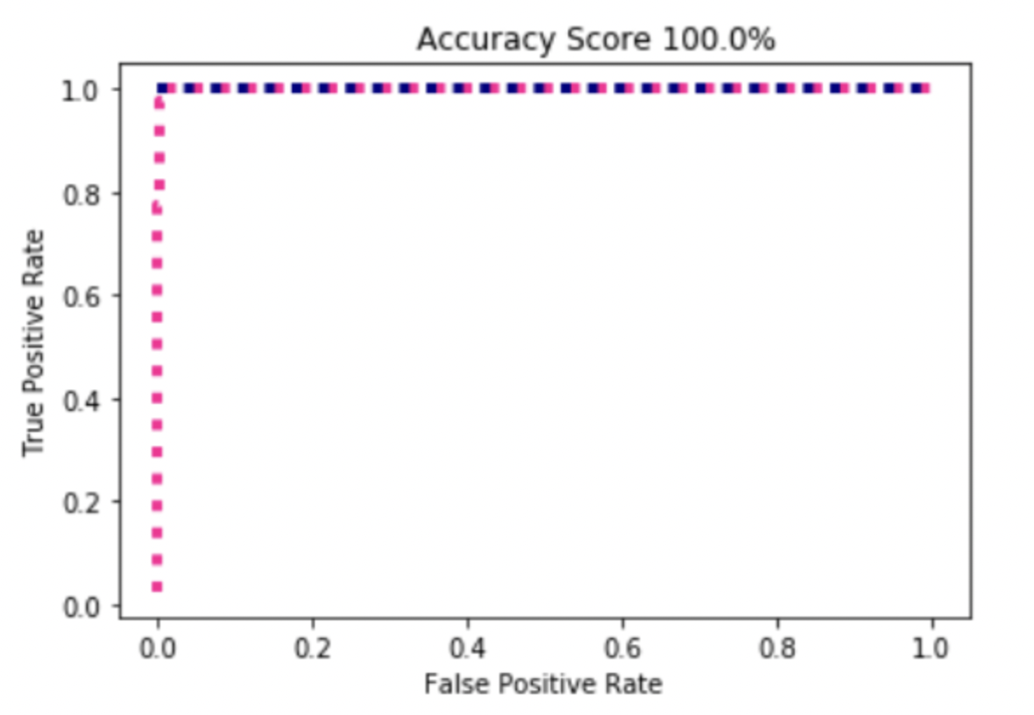
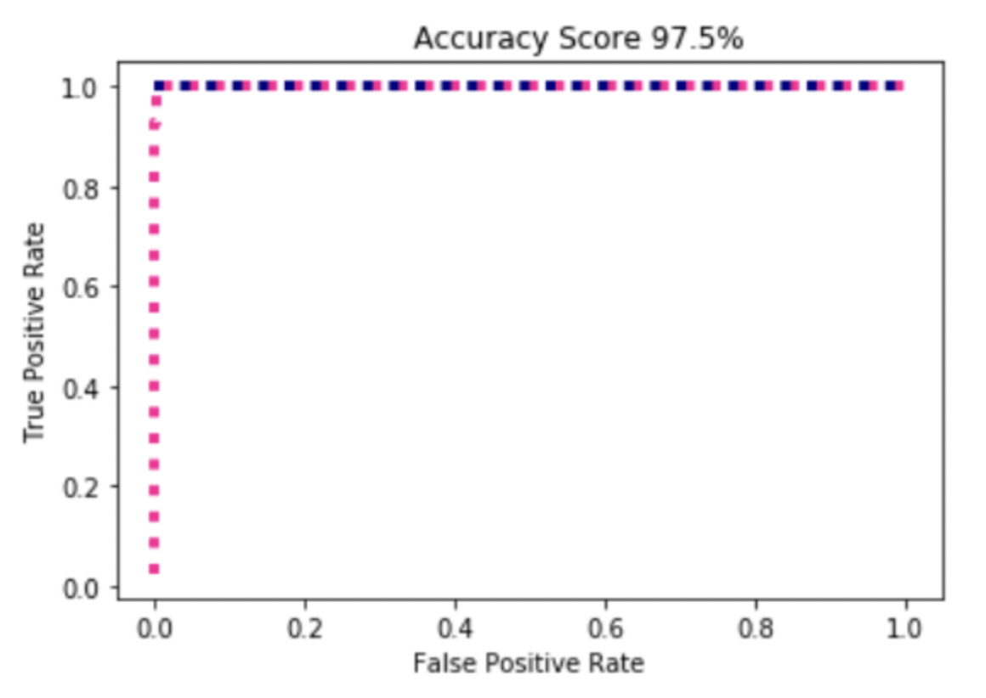
Approach-1 Results
Best-Case Accuracy
Worst-Case Accuracy

Slide 15
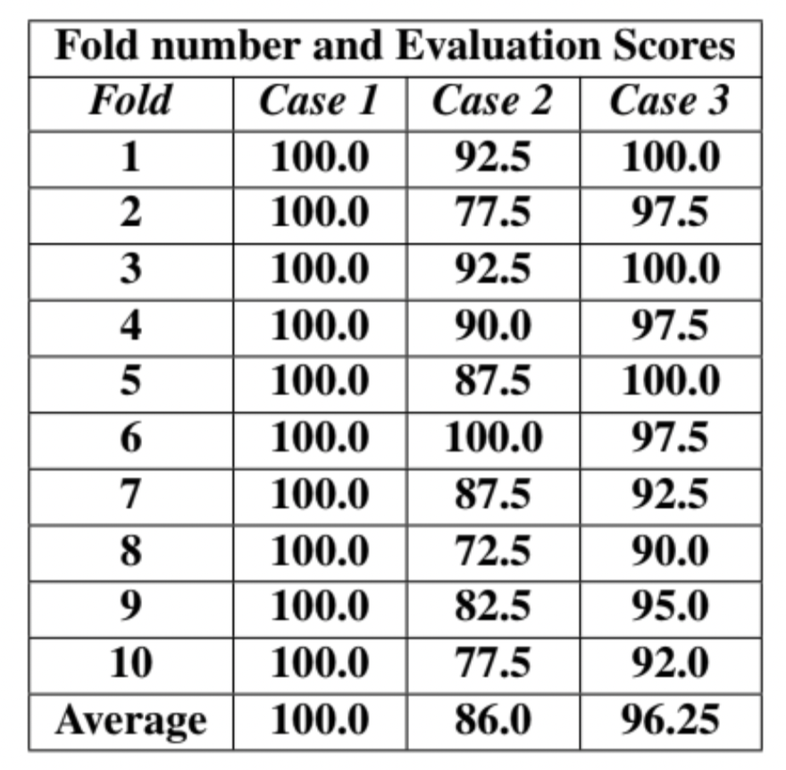
Approach-2 Results
For this approach, we evaluated the performance under three cases:
Case 1 - When each user uses a unique passcode.
Case 2 - Same passcode is used by all users.
Case 3 - When users’ original HOG features are used for classification.

Slide 16
Analysis and Discussion
In approach 1, matching performance of the proposed approach is evaluated in stolen token scenario (worst case) was poor as compared to legitimate token scenario (best case).
In approach 2,
when a unique password mapped key is used, the performance is comparably high.
Same password used by more than one user does not help in authentication step and degrades the performance.
Original HOG feature performance metric, without use of any password mapped key is comparable to mapped ones.

Slide 17
Future Work
Prospective efforts will be aimed to get variable size feature vectors so that we can control the dimensionality.
Modules could be added to detect liveness of the facial images along with the matching process of the revocable biometric system.

Slide 18
Conclusion
Application to enhance the privacy using revocable biometric system has been proposed.
Both approaches discussed are automatic and low-cost solution that does not require any user cooperation.
The system testing was conducted in adverse conditions on authentic data that demonstrate the sturdiness and efficacy of the work proposed.
The performance evaluation of the log-gabor XOR based approach using KDA for dimensionality reduction and HOG feature based using SVM classifier on ORL dataset have satisfying results.

Slide 19
References
[1] A. T. B. Jin, D. N. C. Ling, and A. Goh, “Biohashing: two factor authentication featuring fingerprint data and tokenised random number,” Pattern recognition, vol. 37, no. 11, pp. 2245–2255, 2004.
[2] T. Connie, A. Teoh, M. Goh, and D. Ngo, “Palmhashing: a novel approach for cancelable biometrics,” Information processing letters, vol. 93, no. 1, pp. 1–5, 2005.
[3] A. Teoh, B. Jin, T. Connie, D. Ngo, and C. Ling, “Re- marks on biohash and its mathematical foundation,” Information processing letters, vol. 100, no. 4, pp. 145–150, 2006.
[4] M. Savvides, B. V. Kumar, and P. K. Khosla, “Cancelable biometric filters for face recognition,” in Proceedings of the 17th International Conference on Pattern Recognition, 2004. ICPR 2004., vol. 3. IEEE, 2004, pp. 922–925.
[5] Y. Sutcu, H. T. Sencar, and N. Memon, “A secure biometric authentication scheme based on robust hashing,” in Proceedings of the 7th Workshop on Multimedia and Security, 2005, pp. 111–116.
[6] T. E. Boult, W. J. Scheirer, and R. Woodworth, “Revocable fingerprint biotokens: Accuracy and security analysis,” in 2007 IEEE Conference on Computer Vision and Pattern Recognition. IEEE, 2007, pp. 1–8.
[7] A. B. Teoh and D. C. Ngo, “Biophasor: Token supplemented cancellable biometrics,” in 2006 9th international conference on control, automation, robotics and vision. IEEE, 2006, pp. 1–5.

Slide 20
Thank You!

